Slide 1
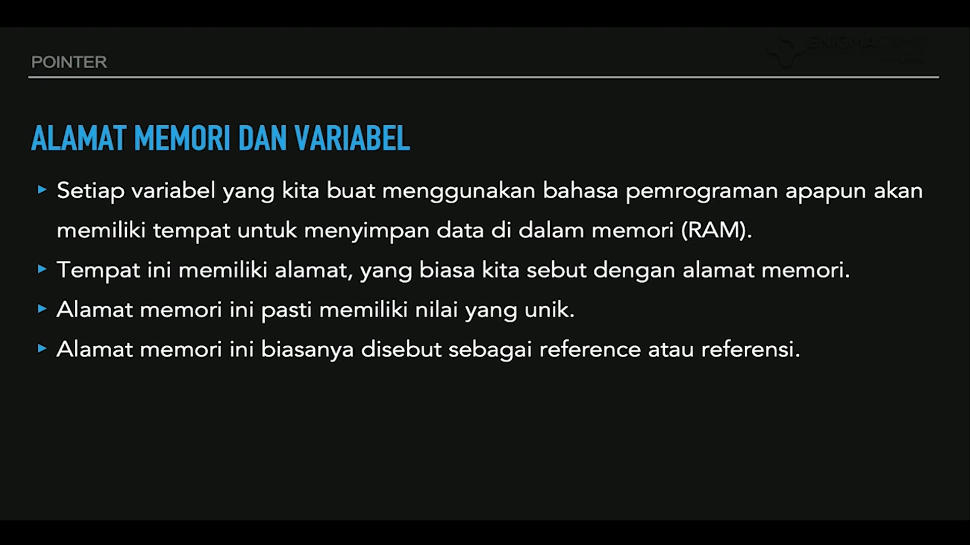

Slide 2
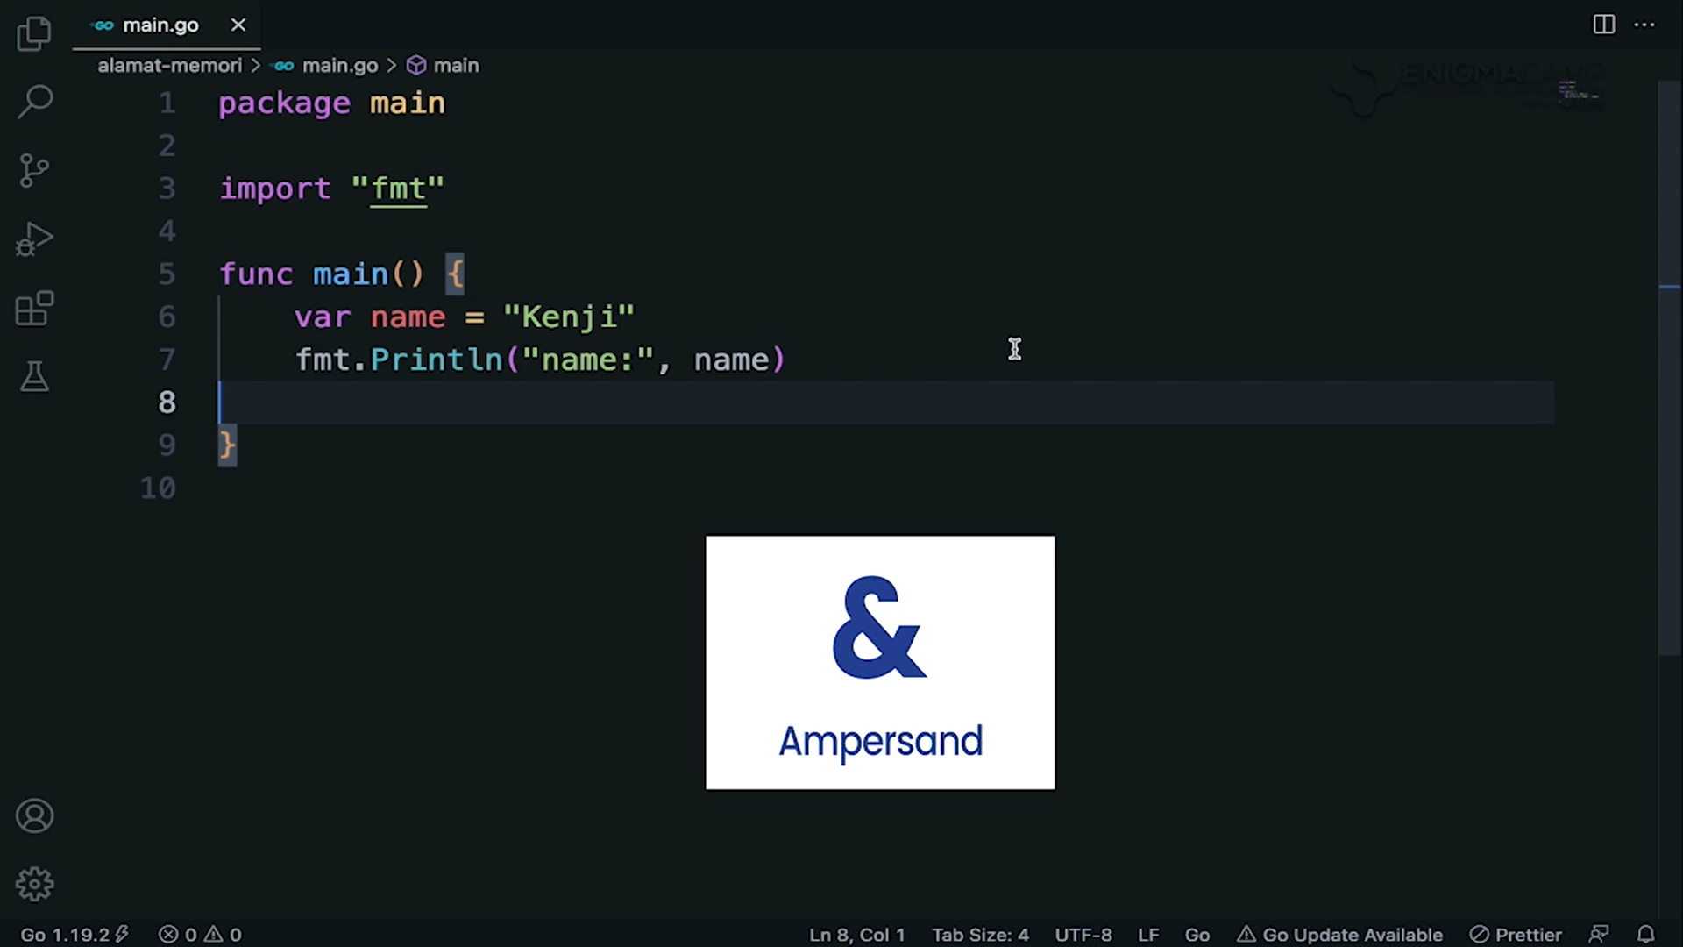
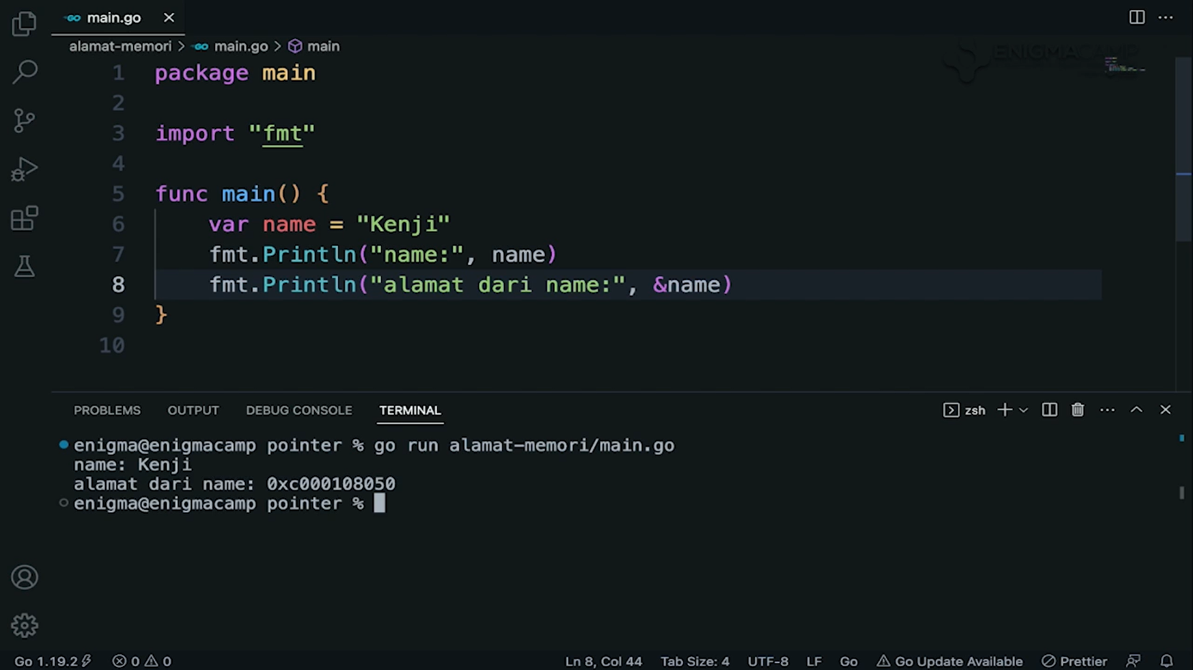
use Symbol Ampersand(&) to check the variable memory address

Slide 3
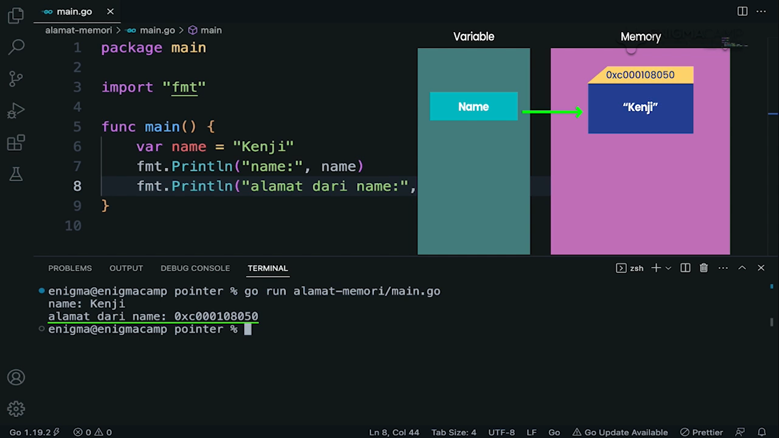
Every variables has memory address where they store their values.

Slide 4
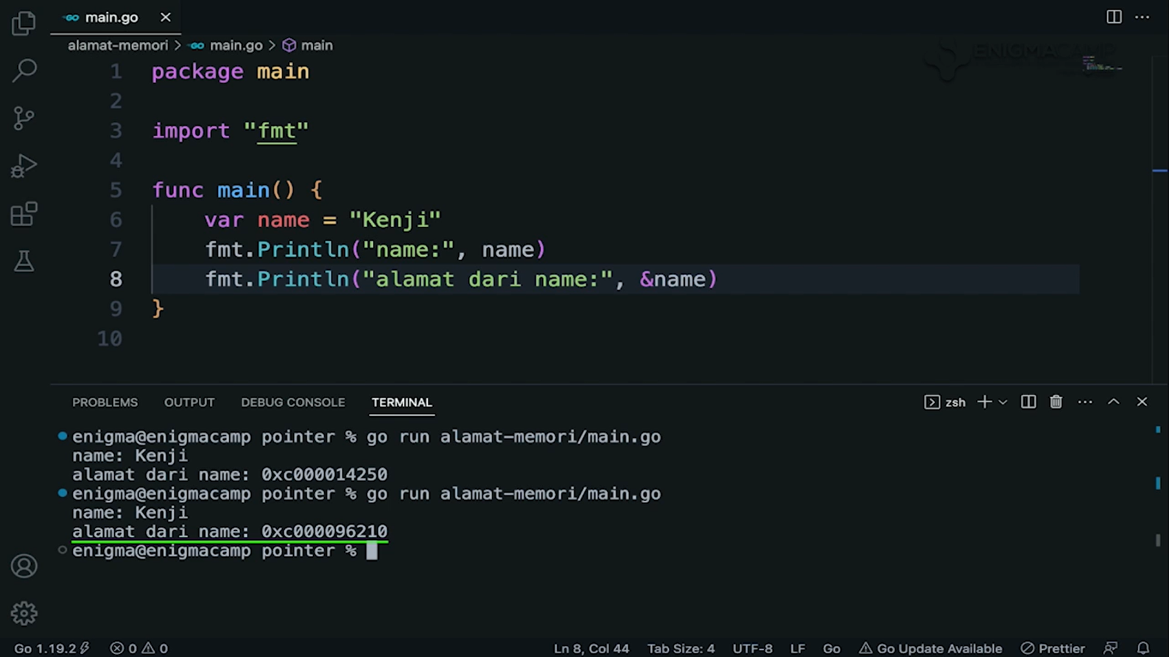
Note that Memory address changes everytime program runs

Slide 5
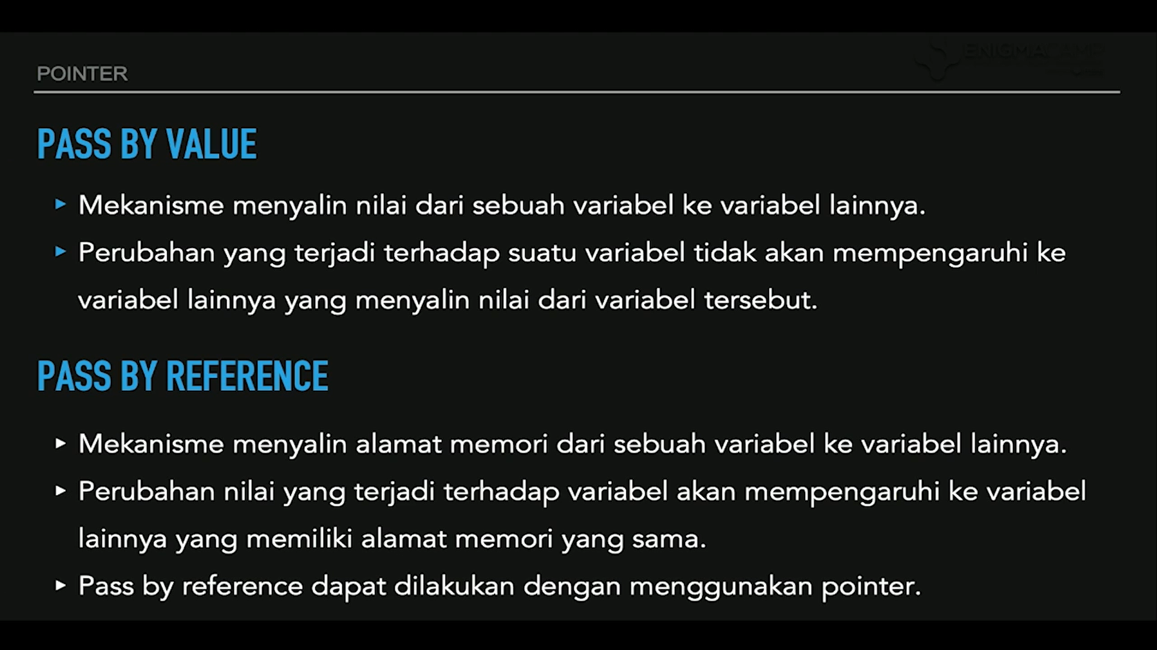

Slide 6
Pass by Value

Slide 7
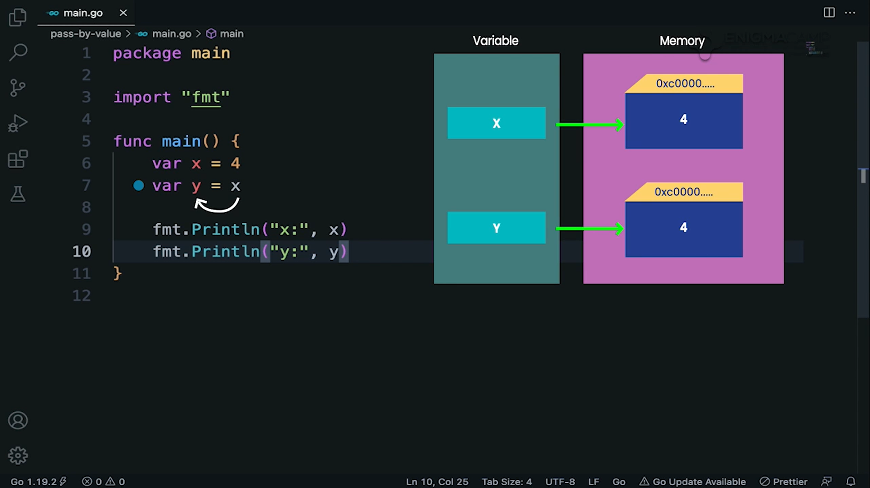
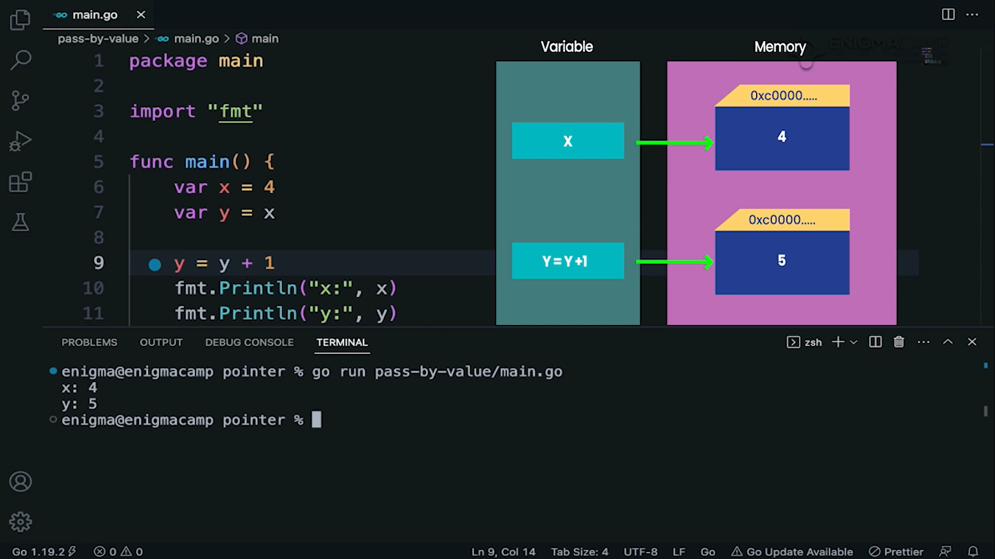
Contoh Pass by Value

Slide 8
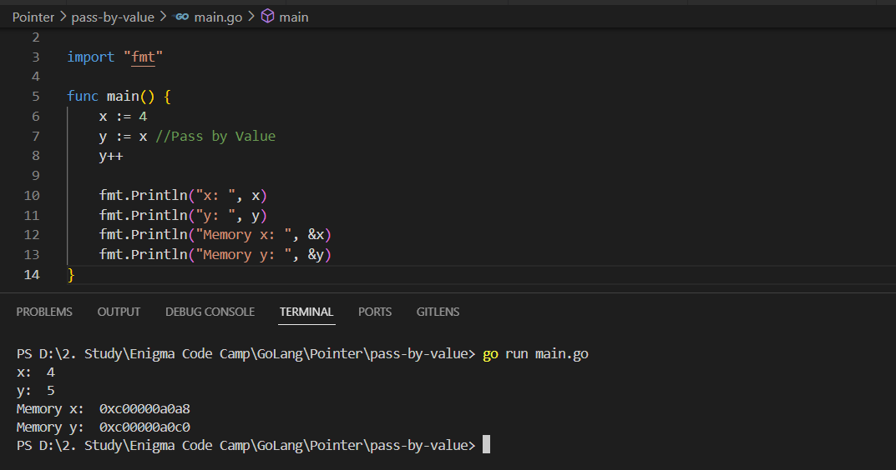
At pass by value, the memory address will be different

Slide 9
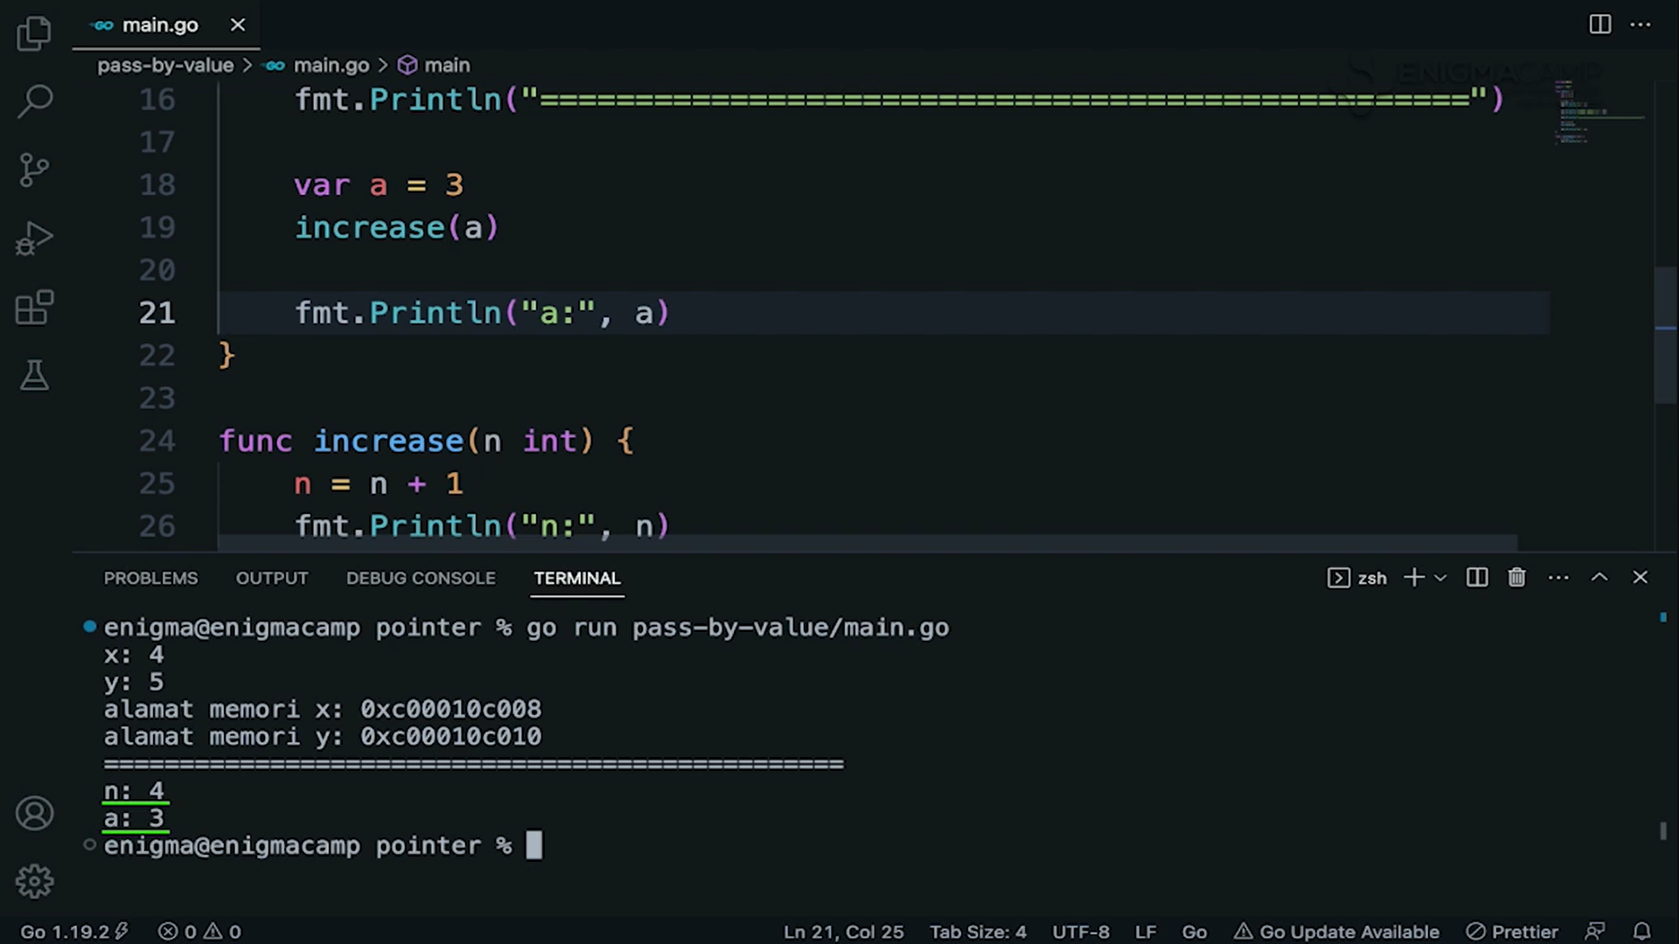
Pass by Value through passing arguement

Slide 10
Pass by Reference

Slide 11
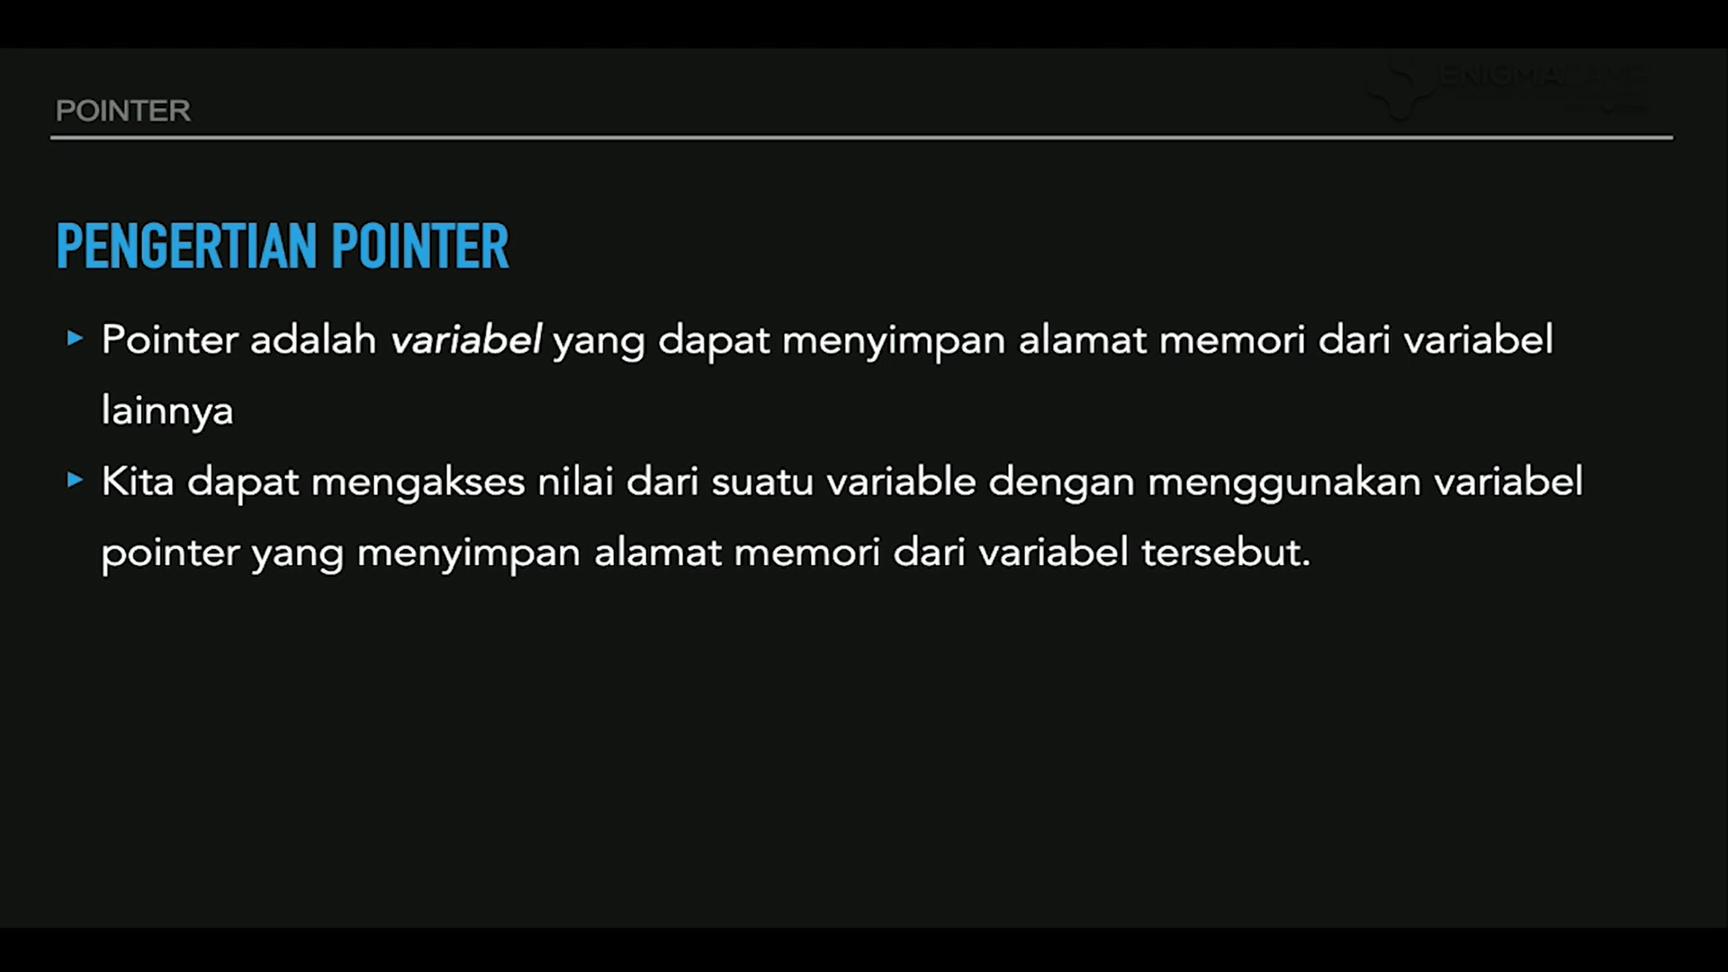

Slide 12
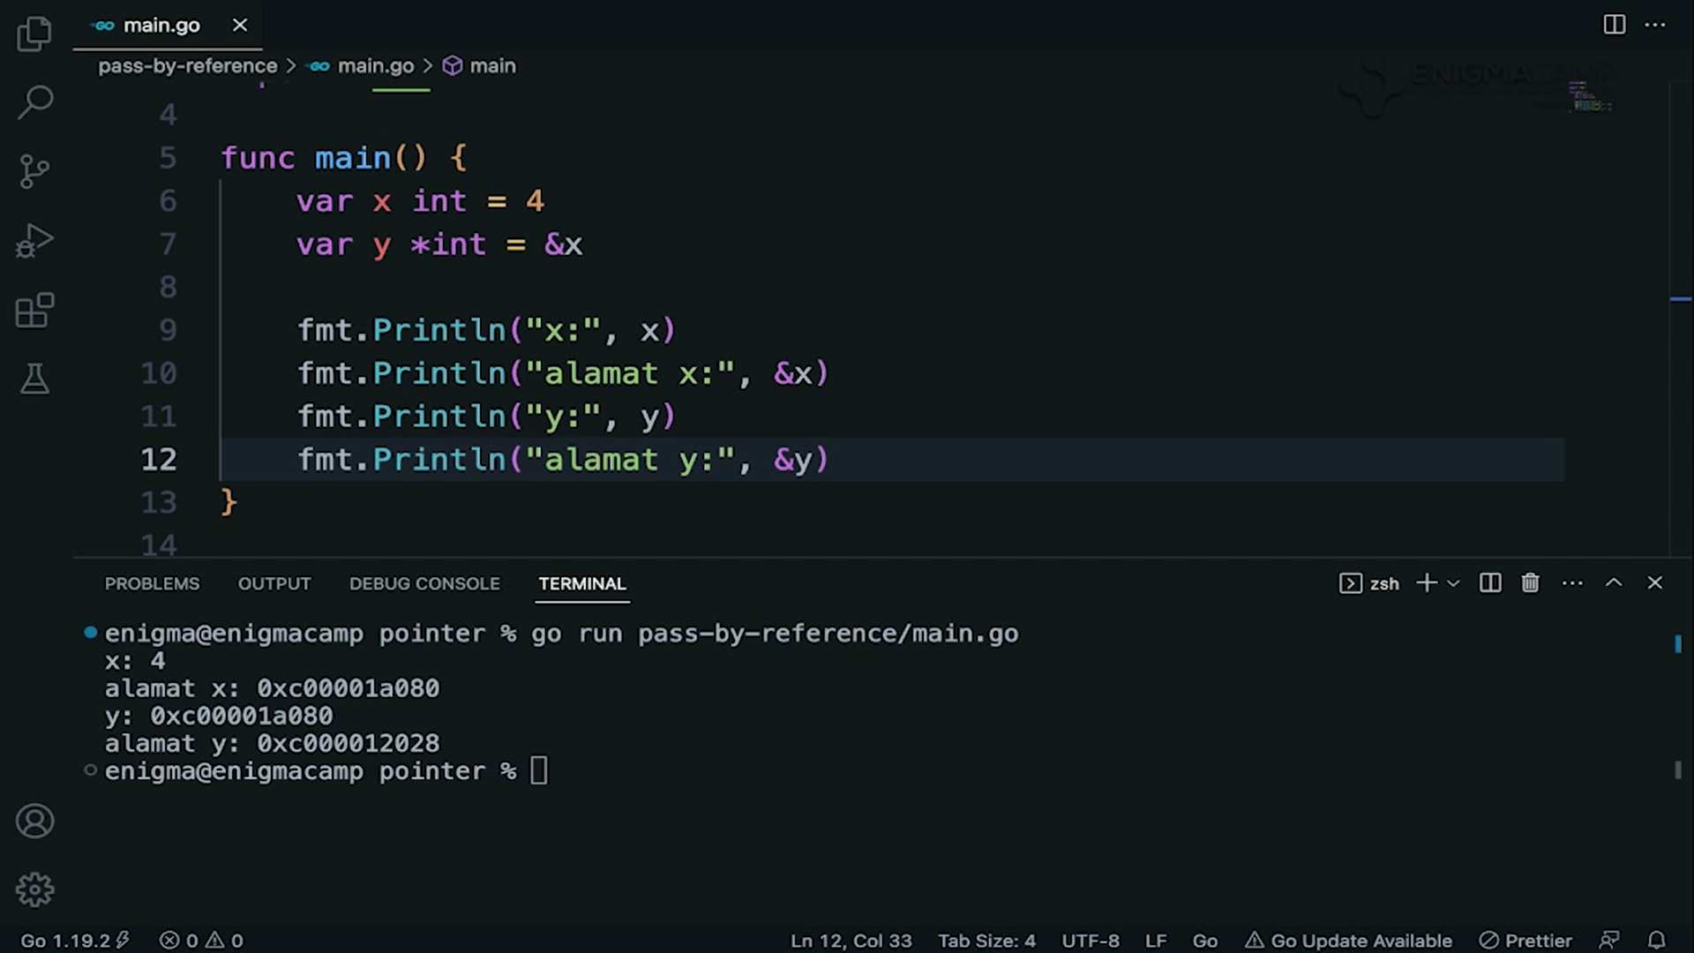
Pointer store variable memory address, and they have their own memory address

Slide 13
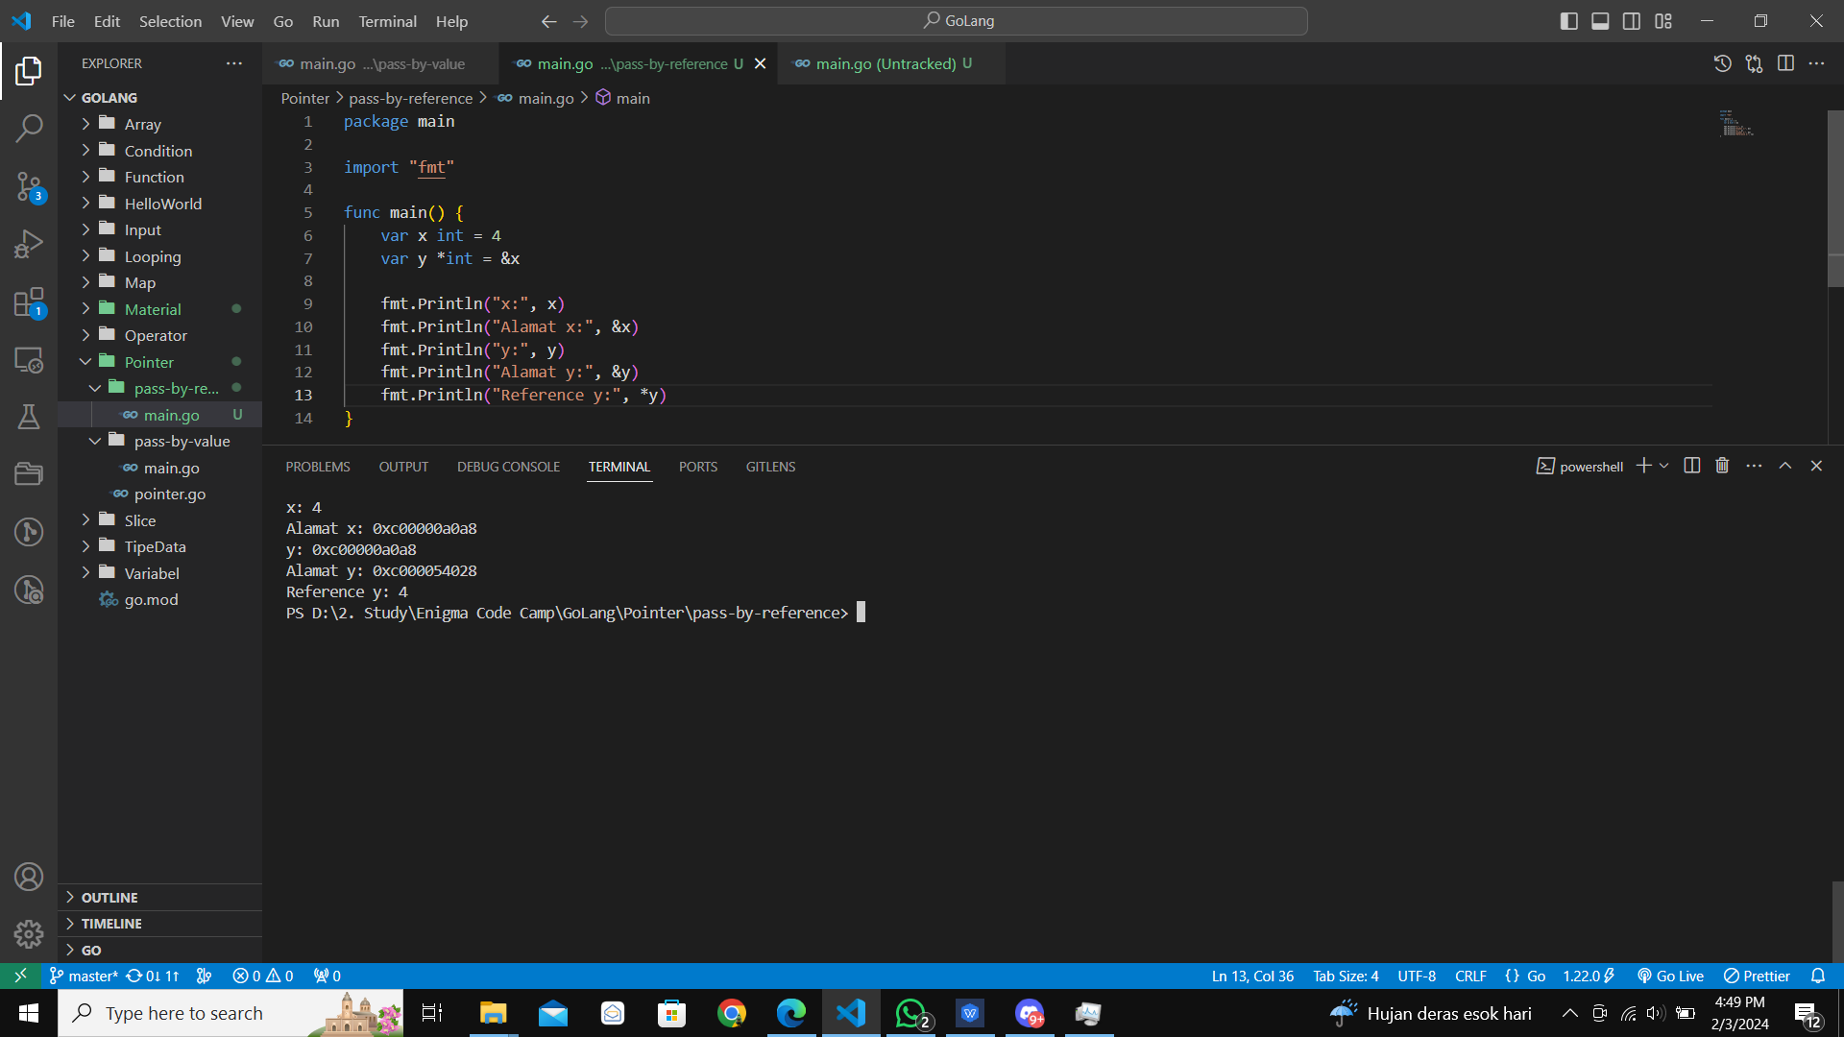
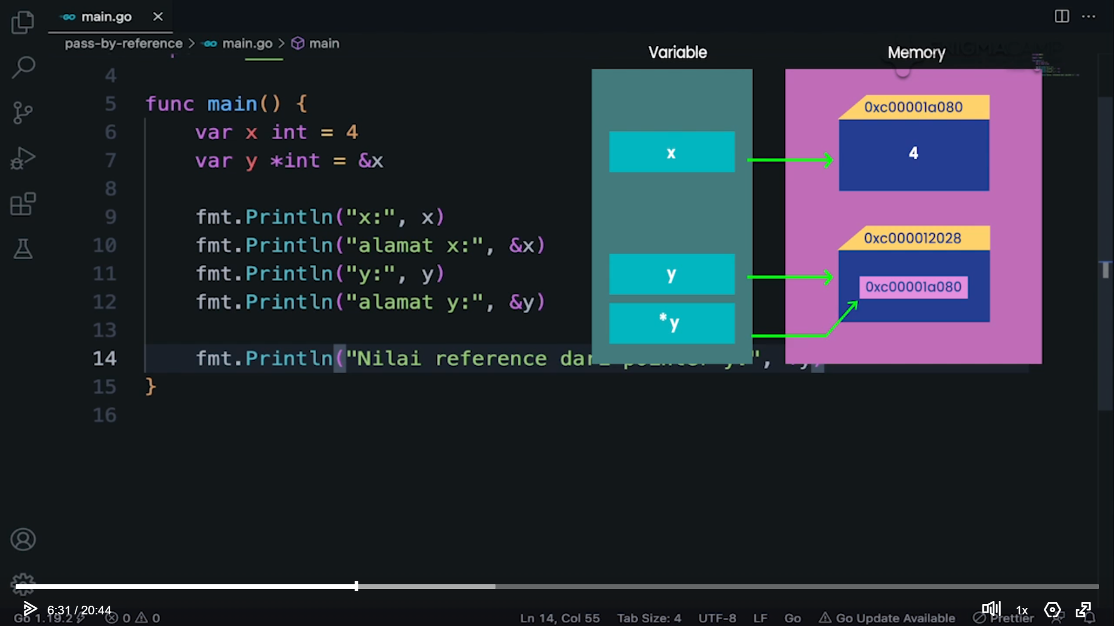
Use (*) To print the variable reference. Since y is a pointer of x, it’s reference will be x value

Slide 14
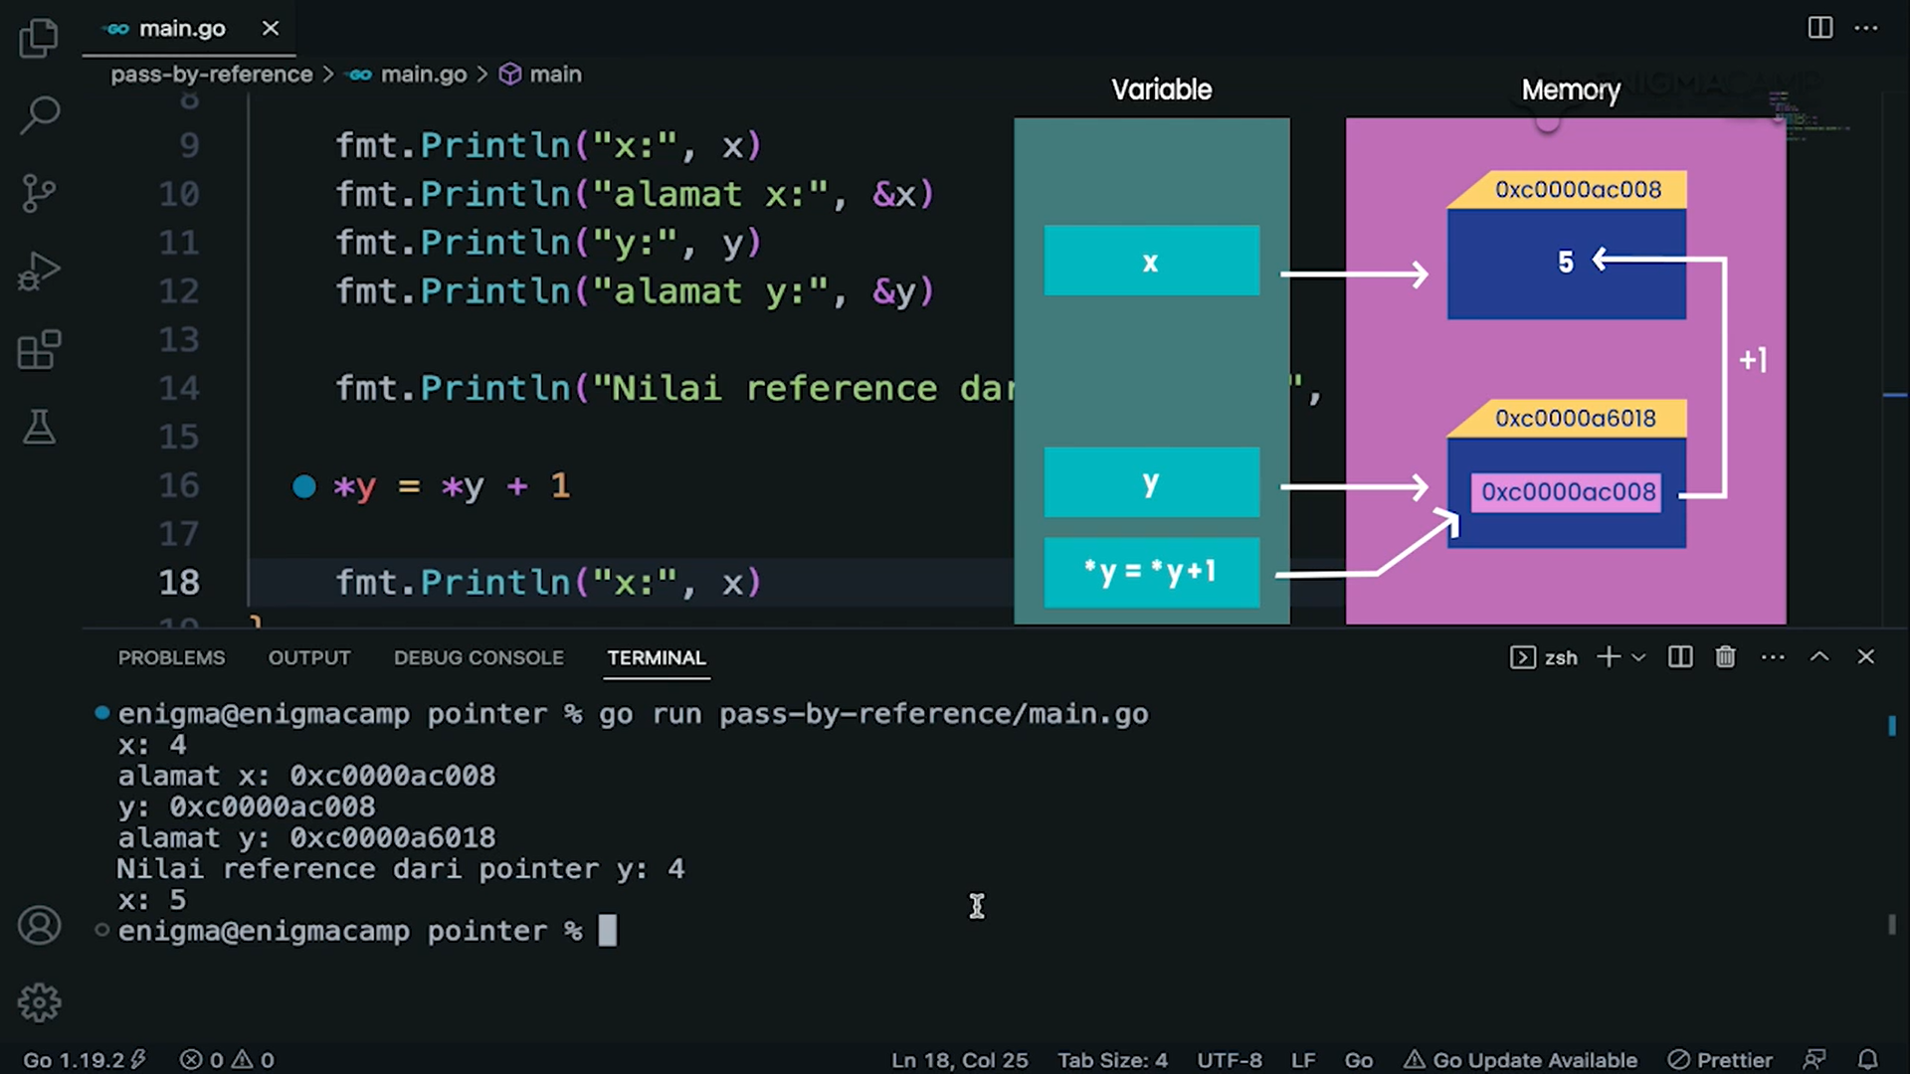
If the pointer value changes, then the original variable value will also changes.

Slide 15
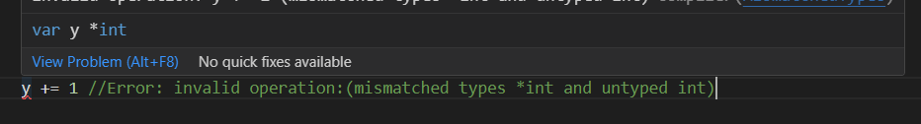
To use a pointer by adding or reassign them, recquire to use the (*) sign

Slide 16

Pay attention what happends to the “x” variable, after you increase the *y. This is Pass by Reference

